Slide 1
Controversies and Conflicting Views in Philippine History
“The Two Faces of 1872 Cavite Mutiny”
Group 2

Slide 2
Intended Learning Outcomes
At the end of the session, the student will be able to:
Demonstrate the ability to formulate arguments in favor or against a particular issue using primary sources (Two Faces of the 1872 Cavity Mutiny)

Slide 3
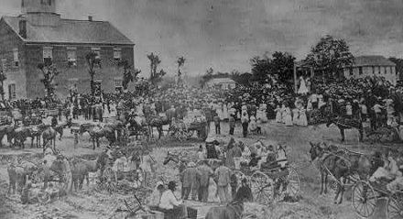
1872
A HISTORIC YEAR OF TWO EVENTS
The 12th June of every year since 1898 is a very important event for all the Filipinos. In this particular day, the entire Filipino nation as well as Filipino communities all over the world gathers to celebrate the Philippine’s Independence Day.
1898 came to be a very significant year for all of us but we should be reminded that another year is as historic as 1898-1872
There will be no 1896 Philippine Revolution if there was no 1872 Cavite Mutiny.

Slide 4
1872
A HISTORIC YEAR OF TWO EVENTS
2 Major Events Happened in 1872:
1. 1872 Cavite Mutiny
2. Martyrdom of the three priests in the persons of Fathers Mariano Gomes, Jose Burgos and Jacinto Zamora (GOMBURZA)

Slide 5
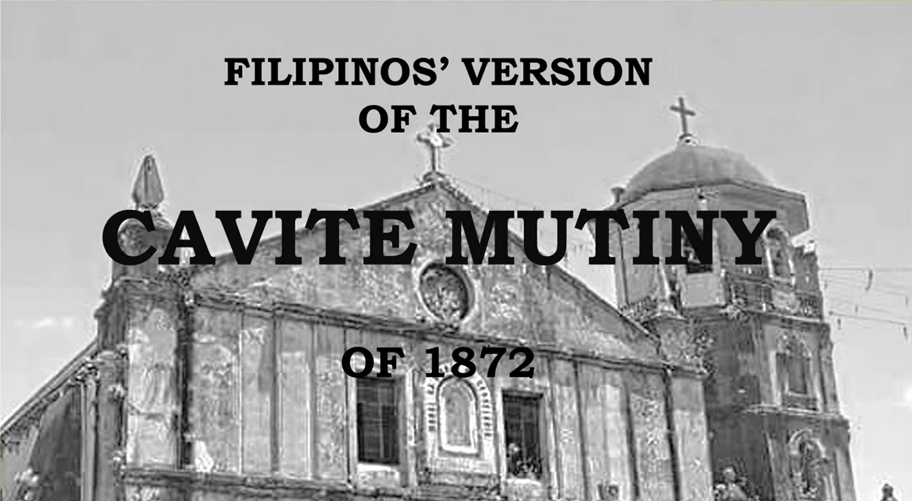

Slide 6
Mutiny
A rebellion against authority
comes from an old verb, “mutine” which means “revolt”

Slide 7
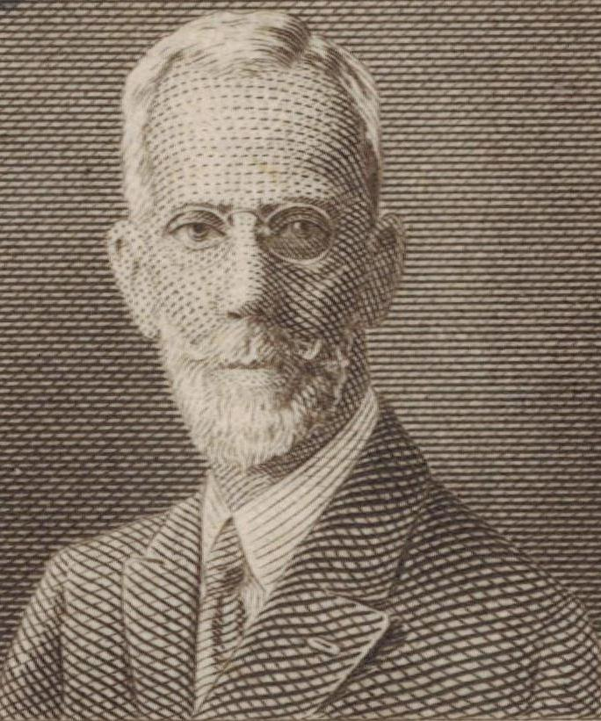
Dr. Trinidad Hermenegildo Pardo De tavera
A Filipino scholar and researcher
wrote a Filipino version of the bloody incident in cavite.

Slide 8
According to Pardo De Tavera
The incident was merely amutiy by Filipino soldiers and laborers of the Cavite arsenal to the dissatisfaction arising from the draconian policies of Izquierdo (abolition of priveleges and prohibition of the founding of the school of arts and trades.

Slide 9
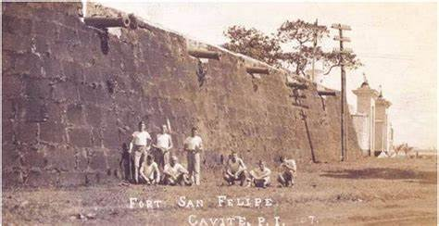
Cavite Mutiny
Uprising of military personnel of Fort San Felipe (the Spanish arsenal in Cavite, Philippines) on January 20, 1872.
Around 200 soldiers and laborers rose up in the belief that it woukd elevate to a national uprsing. The mutiny was unsuccessful, and government soldiers executed many of the participants.

Slide 10
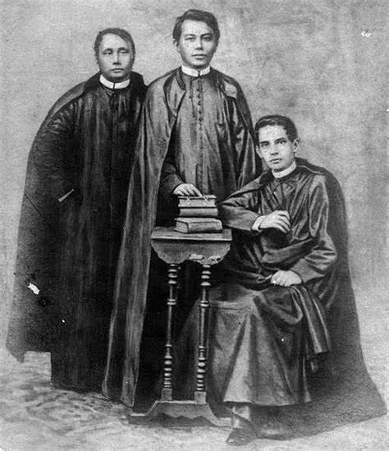
GOMBURZA
collective name of the three martyred priests
tagged as the masterminds of the Cavite Mutiny
They were prominent Filipino priests charged with treason and sedition.
The Spanish clergy connected the priests to the mutiny as part of a conspiracy to stifle the movement of secular priests who desired to have their own parishes instead of being assistants to the regular friars.

Slide 11
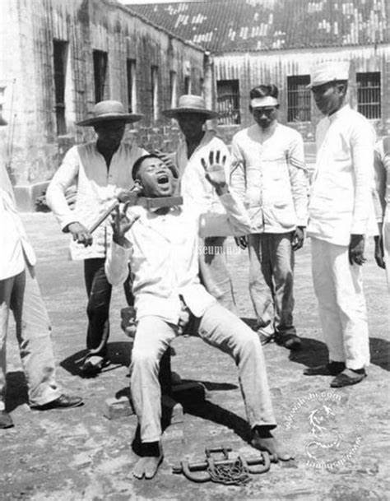
Garrote
killing someone by strangulation typically with an iron wire or cord

Slide 12
February 17, 1872
The GOMBURZA were executed by garrote in public to serve as a threat to Filipinos never to attempt to fight the Spaniards again.
This is a scene purpotedly witnessed by a Young Jose Rizal

Slide 13
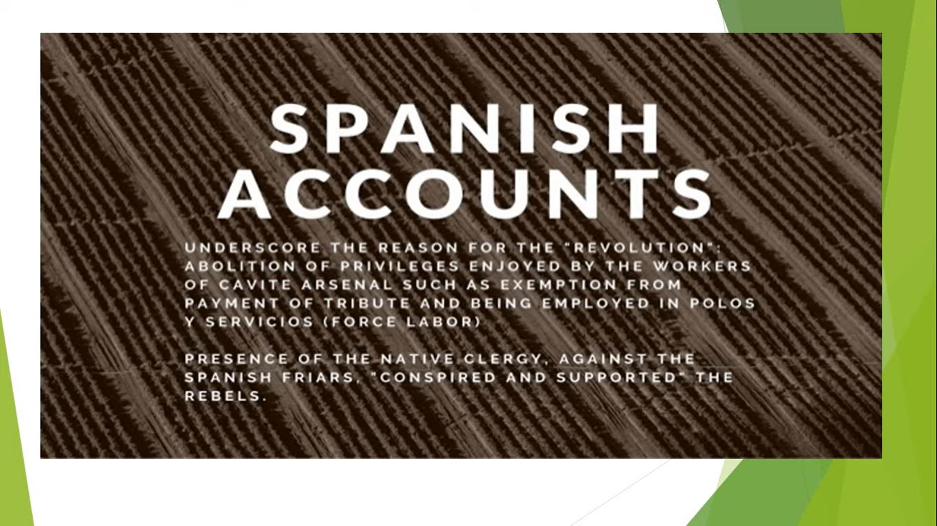

Slide 14
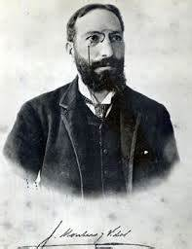
Cavite Mutiny of 1872 (Spanish Version)
a prolific Spanish historian documented the event and highlighted it as an attempt of the Indios to overthrow the Spanish government in the Philippines.
Meanwhile, Gov. Gen. Rafael Izquierdo’s official report to the King of Spain magnified the event and made use of it to implicate the native clergy, which was then active in the call for secularization.
SECULARIZATION - magkaroon ng magandang katungkulan ang mga native clergies (mga Pilipnong pari) dito sa Pilipinas na hindi nagustohan ng mga prayleng Espanyol.

Slide 15
1872 (in the Spaniard’s Accounts)
was premeditated a part of a big conspiracy among educated leaders, mestizos, lawyers and residents of Manila and Cavite
They allegedly plan to liquidate high-ranking Spanish officers then kill friars

Slide 16
January 20, 1872
The district of Sampaloc celebrated the feast of the Virgin Loreto came with it were some fireworks display
The Caviteños mistook this as the signal to commence with the attack.

Slide 17
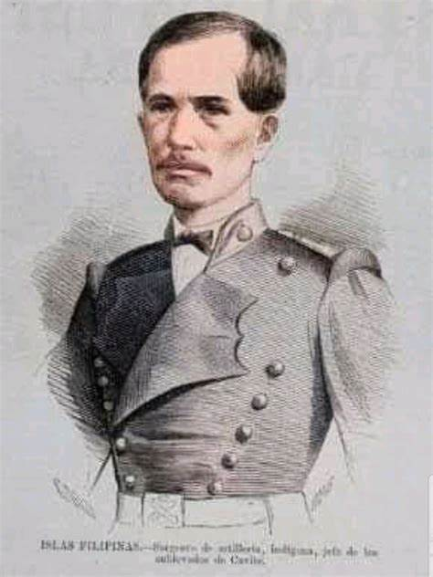
Spanish Accounts
200 men was led by Sergeant Lamadrid attacked Spanish officers at sight and seized the arsenal
Izquierdo, upon learning the attack, ordered reinforcement of the Spanish forces in Cavite to quell the revolt
The revolution was easily crushed, when Manileños who were expected to aid the Caviteños did not arrive

Slide 18
In result
Leaders of the plot were killed.
GOMBURZA father’s were tried by a court-martial and sentenced to be executed.

Slide 19
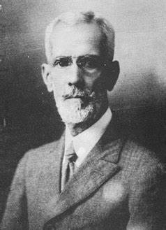
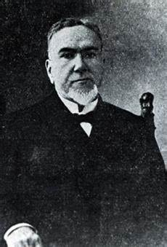
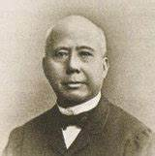
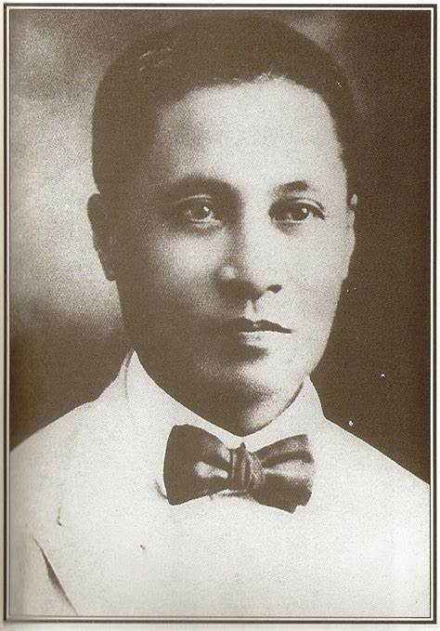
Others who were implicated such as
Other Filipino lawyers were suspended from the practice of law, arrested and sentences to life imprisonment at the Marianas Island.
Joaquin Pardo De Tavera
Antonio Ma. Regidor
Jose Basa
Pio Basa

Slide 20
2 Versions of Cavite Mutiny
Filipino Version - its a simple mutiny by the native Filipino soldiers and laborers of the Cavite arsenal who turned out to be dissatisfied with the abolition of their privileges.
Spanish Version - an attempt of the Indios to overthrow the Spanish government in the Philippines.

Slide 21
Our Philippine Independence can be traced back from the Cavite Mutiny
CAVITE MUTINY
DEATH OF GOMBURZA
JOSE RIZAL’S
EL FILIBUSTERISMO/NOLI ME TANGERE
1896 PHILIPPINE REVOLUTION

Slide 22
Thank you :)

